Slide 1
Comparing classification models to predict NBA GAME OUTCOMES
Danielle Angelini
DS504

Slide 2
National Basketball Association Summary
WHY The National Basketball Association (NBA) is worth over $90 billion across all teams as of 2022. The sports betting industry is worth over $83 billion as of 2022. Being able to predict NBA game outcomes allows sport company and sport betting leaders to make profitable business decisions. How can we use data analytics to create greater value in the sports industry? | WHAT What game statistics are important to consider and have the most impact on a game outcome? Can we create a model that can accurately predict an outcome of an NBA game? Which type of classification model would give the best results? What can we take away to aid in business decisions? | HOW Popular classification models used for predicting game outcomes include logistic regression models, random forest classifiers, support vector machines, XGBoost classifiers, and Gaussian Naïve Bayes Classifiers. Tools like R are useful to implement these models. | THE DATA From Kaggle 20,000+ games 40+ game statistics such as game date, season year, home team, visitor team, and number of games, home and road win percentages, points, rebounds, assists, FG %, FT %, and FG3 % for both teams. 19 years of data from 2003 to 2022 30 teams
Notes:
https://www.sportico.com/feature/nba-valuations-average-team-worth-billion-warriors-1234698263/
https://www.grandviewresearch.com/industry-analysis/sports-betting-market-report#:~:text=The%20sports%20betting%20market%20was,USD%20182.12%20billion%20by%202030.

Slide 3
What can we expect from our data...
The target variable’s perspective is of the home team.
Joined games and rankings datasets from Kaggle by game date and home team ID to create a master games dataset
Upon initial data processing, there were 39 duplicate games, 99 blank games, and 2,651 outliers based on both home and away points, assists, rebounds, field goal %, free throw %, and three-pointer %.

Slide 4
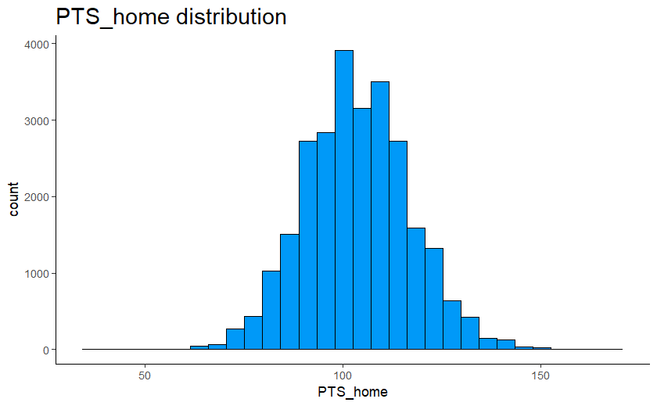
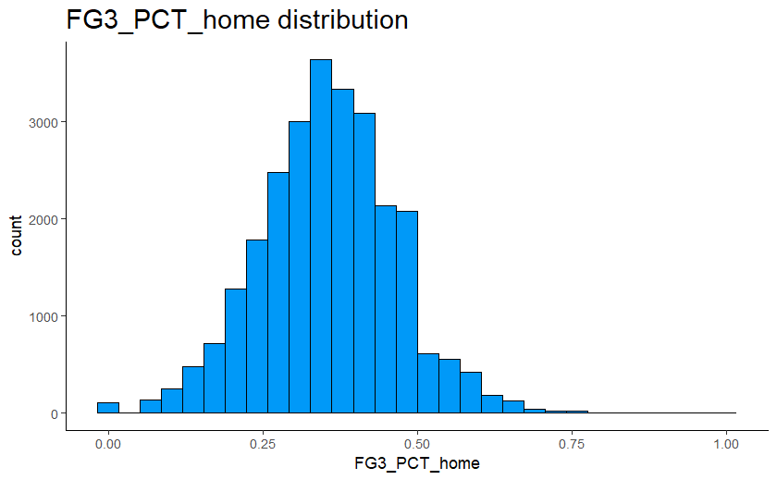
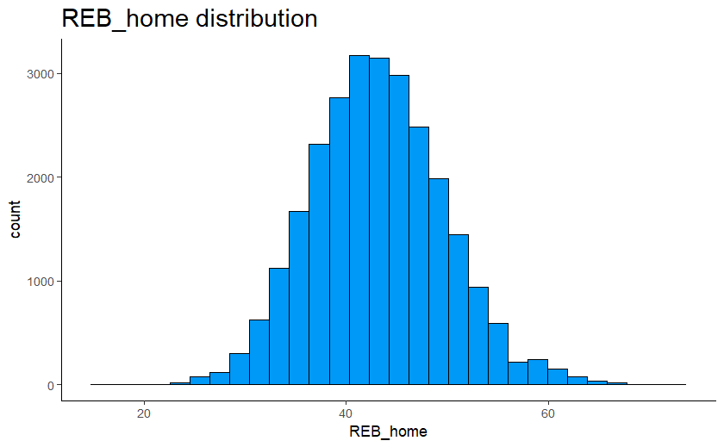
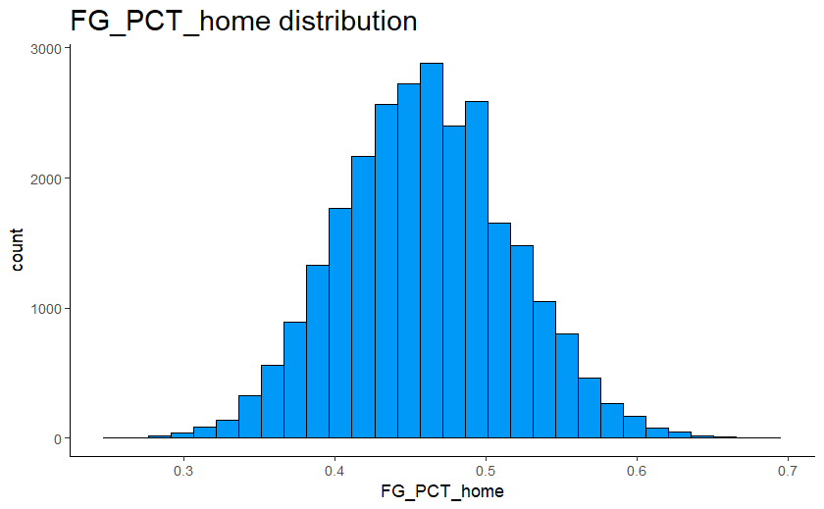
For our main game statistics, we see a normal distribution meaning less randomness in the dataset...

Slide 5
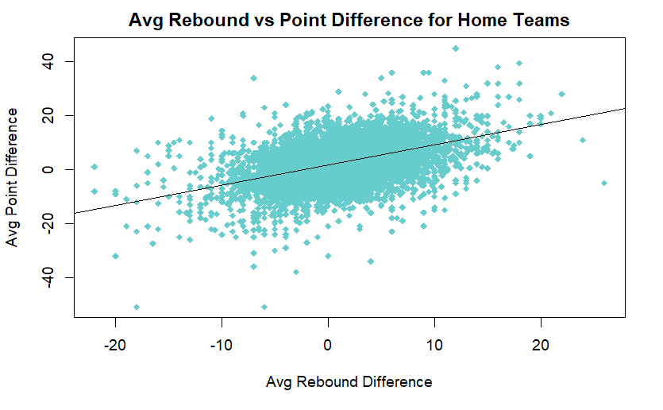
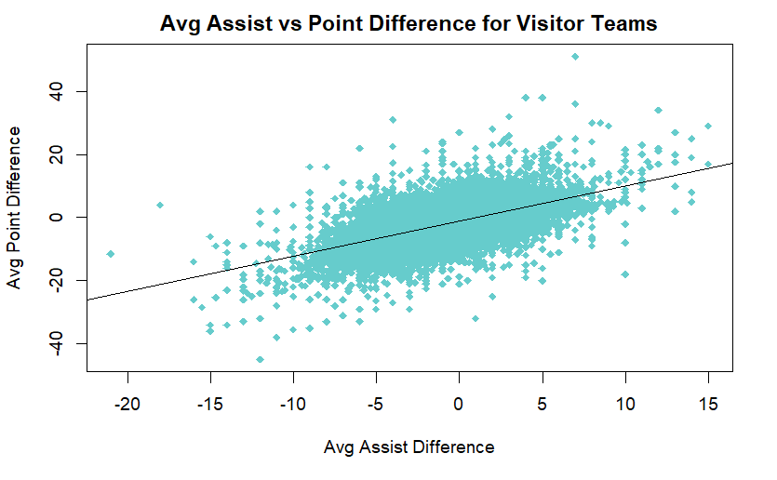
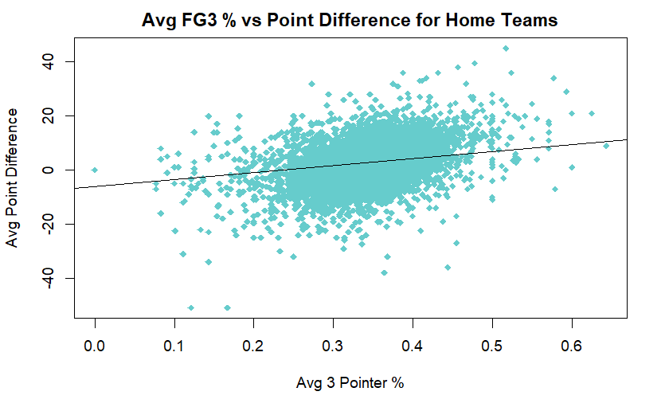
...and our variables tend to be positively correlated with point differentials, which is the most obvious game winning factor

Slide 6
Would target leakage exist with our current dataset?
Target leakage occurs when predictors include data that will not be available at the time of prediction.
Statistics like points, rebounds, assists, and shooting statistics of a given game are not going to be known until after we know the outcome of the game.
We need to remove target leakage from the dataset through creating a dataset with only statistics known up until a given game.
Notes:
Target leakage occurs when your predictors include data that will not be available at the time you make predictions.

Slide 7
...which brings us to our new dataset
Original Dataset Variables | Modified Dataset
Game Date, Game ID, Season, Home Team ID, Game Status, Visitor Team ID, Team_ID_X, XT_G, XT_W, XT_W_PCT, Home Team Home Record, Home Team Road Record, PTS_X, FG_PCT_X, FT_PCT_X, FG3_PCT_X, AST_X, REB_X, HOME_TEAM_WINS | Game Date, Game ID, Season, Team_ID_X, XT_G, XT_W_PCT, XT_HOME_W_PCT, XT_ROAD_W_PCT, TOT_PTS_X, AVG_PT_DIF_X, AVG_FG_PCT_X, AVG_FT_PCT_X, AVG_FG3_PCT_X, TOT_AST_X, TOT_REB_X, AVG_AST_DIF_X, AVG_REB_DIF_X, PTLast3_X, REBLast3_X, ASTLast3_X, FG_PCTLast3_X, FT_PCTLast3_X, FG3_PCTLast3_X, HOME_TEAM_WINS
*For listing purposes, X is a stand in for variables that occur for both home and away teams.

Slide 8
What do these new variables mean?
Modified Dataset | Modified Dataset
TOT_PTS_X, TOT_AST_X, TOT_REB_X | Season total points, assists, and rebounds up until current game
AVG_FG_PCT_X, AVG_FT_PCT_X, AVG_FG3_PCT_X | Season average field goal, free throw, and three-pointer percentage up until current game
AVG_PT_DIF_X, AVG_AST_DIF_X, AVG_REB_DIF_X | Season average point, assist, and rebound differential up until current game
PTLast3_X, REBLast3_X, ASTLast3_X, | Total points, assists, and rebounds of last three games
FG_PCTLast3_X, FT_PCTLast3_X, FG3_PCTLast3_X | Average field goal, free throw, and three-pointer percentage of last three games
*For listing purposes, X is a stand in for variables that occur for both home and away teams.

Slide 9
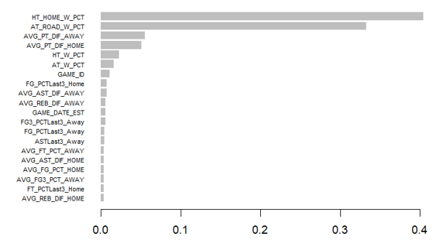
What can we expect from our new dataset?
With a preliminary logistic regression run, the following variables are considered important from most to least:
 | P - value | Predictor Variable
*** | < 0.001 | HT_HOME_W_PCT, AVG_PT_DIF_HOME, AT_ROAD_W_PCT, AVG_PT_DIF_AWAY
** | < 0.01 | AVG_AST_DIF_HOME
* | < 0.05 | GAME_DATE_EST, TOT_AST_HOME
. | < 0.1 | SEASON, TOT_REB_HOME, REBLast3_Home, AVG_FG3_PCT_AWAY, PTLast3_Away, FG_PCTLast3_Away
With a preliminary XGBoost classification run, the following variables are considered important from most to least:

Slide 10
What can we do with these important variables?
Based on the table and importance graph, it looks like the following variables should be considered: HT_HOME_W_PCT, AVG_PT_DIF_HOME, AT_ROAD_W_PCT, and AVG_PT_DIF_AWAY
Creating interactions of these variables could improve results.
Can do this through adding a polynomial of a given variable into the relationship between the target and predictor variables

Slide 11
What can we do with these important variables?
For each variable, let’s see what degree polynomial would decrease the test mean squared error using a basic logistic regression model:
Predictor Variable | Most Optimal Degree | Test MSE Achieved
HT_HOME_W_PCT | 4 | 0.2297
AVG_PT_DIF_HOME | 6 | 0.2294
AT_ROAD_W_PCT | 3 | 0.2277
AVG_PT_DIF_AWAY | 3 | 0.2276
AVG_PT_DIF_AWAY performed best overall
Although AT_ROAD_W_PCT has a lower error score than HT_HOME_W_PCT, it would be interesting to consider HT_HOME_W_PCT instead given its importance according to XGBoost.
Notes:
Variation 1: AVG_PT_DIF_HOME: 0.2294, 0.7706
Variation 1*: HT_HOME_W_PCT: 0.2297, 0.7703
AVG_PT_DIF_AWAY: 0.2276, 0.7724
AT_ROAD_W_PCT: 0.2277, 0.7723
poly(AVG_PT_DIF_HOME, 6) + poly(AVG_PT_DIF_AWAY, 3) + poly(HT_HOME_W_PCT, 4) + poly(AT_ROAD_W_PCT, 3)

Slide 12
What else can we expect from our dataset? Is multicollinearity a concern?
Multicollinearity occurs when two or more independent variables are highly correlated, which becomes more of a concern for regression models.
Although classification models tend to be tree-based, it is still important to investigate multicollinearity especially for logistic regression.
We can measure multicollinearity of variables using variance inflation factor (VIF). A VIF > 5 tends to be a good measure for detecting multicollinearity.

Slide 13
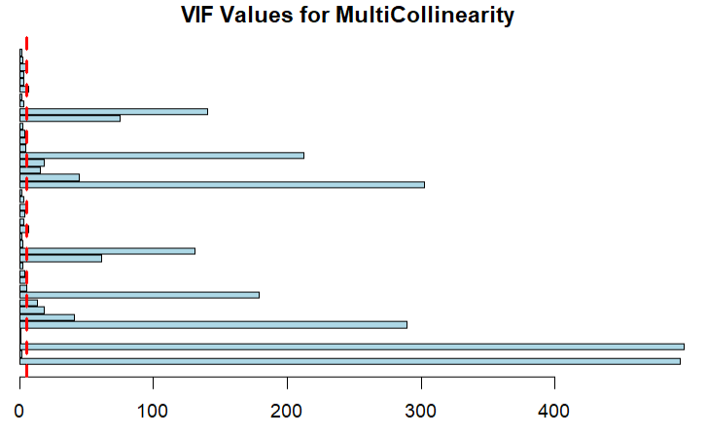
Which variables have high multicollinearity?
VIF | Predictor Variables
VIF > 5 | GAME_DATE_EST, HT_HOME_W_PCT, HT_ROAD_W_PCT, HT_W_PCT, TOT_PTS_HOME, SEASON, HT_G, TOT_REB_HOME, PTLast3_Home, AT_G, FG_PCTLast3_Home, AT_W_PCT, AT_HOME_W_PCT, AT_ROAD_W_PCT, TOT_PTS_AWAY, TOT_AST_AWAY, TOT_REB_AWAY
VIF > 50 | GAME_DATE_EST, SEASON, HT_G, AT_G, TOT_PTS_AWAY, TOT_PTS_HOME, TOT_REB_HOME, TOT_AST_HOME, TOT_REB_AWAY, TOT_AST_AWAY

Slide 14
How can we use this dataset to predict a game’s outcome?
Label this as a classification problem
Use a train-test split of 70% - 30%
Models to consider: logistic regression, random forest classifier, XGBoost classifier, SVM, and Gaussian Naïve Bayes classifier
Performance metrics: accuracy, test error, and confusion matrices
Tools: R

Slide 15
How can we use this dataset to predict a game’s outcome?
The following model variations will be considered across model types where applicable:
Variation Description | Variation Reasoning
Base Model | Basic model considering all features with no feature interaction.
Variation 1: poly(AVG_PT_DIF_AWAY, 3) | Variable was considered to have high significance with logistic and XGBoost summary. Degree was selected based on which gave minimal test MSE.
Variation 2: poly(HT_HOME_W_PCT, 4)
Variation 3: - GAME_DATE_EST - SEASON - HT_G - AT_G - TOT_PTS_AWAY - TOT_PTS_HOME - TOT_REB_HOME - TOT_AST_HOME - TOT_REB_AWAY - TOT_AST_AWAY | Removing predictor variables with a high VIF > 50.
Variation 4: - GAME_DATE_EST - HT_HOME_W_PCT - HT_ROAD_W_PCT - HT_W_PCT - TOT_PTS_HOME - SEASON - HT_G - TOT_REB_HOME - PTLast3_Home - AT_G - FG_PCTLast3_Home - AT_W_PCT - AT_HOME_W_PCT - AT_ROAD_W_PCT - TOT_PTS_AWAY - TOT_AST_AWAY - TOT_REB_AWAY | Removing all predictor variables with a VIF > 5.
Notes:
**ADD FOR VARIATION 1 WITH HT_HOME_W_PCT GIVEN XGBOOST IMPORTANCE!
poly(AVG_PT_DIF_HOME, 6) + poly(AVG_PT_DIF_AWAY, 3) + poly(HT_HOME_W_PCT, 4) + poly(AT_ROAD_W_PCT, 3)
#High Multicollinearity:
GAME_DATE_EST, HT_HOME_W_PCT, HT_ROAD_W_PCT, HT_W_PCT, TOT_PTS_HOME, SEASON*, HT_G, TOT_REB_HOME, PTLast3_Home, AT_G, FG_PCTLast3_Home, AT_W_PCT, AT_HOME_W_PCT, AT_ROAD_W_PCT, TOT_PTS_AWAY, TOT_AST_AWAY, TOT_REB_AWAY
#Really High Multicollinearity:
GAME_DATE_EST, SEASON, HT_G, AT_G, TOT_PTS_AWAY, TOT_PTS_HOME, TOT_REB_HOME, TOT_AST_HOME, TOT_REB_AWAY, TOT_AST_AWAY

Slide 16
Logistic Model Results
The following accuracy and test mean squared errors were produced by each variation:
Variation | Test MSE | Accuracy
Base Model | 0.2321 | 0.7679
Variation 1 | 0.2276 | 0.7724
Variation 2 | 0.2297 | 0.7703
Variation 3 | 0.2321 | 0.7679
Variation 4 | 0.3657 | 0.6433
Notes:
Variation 1: AVG_PT_DIF_HOME: 0.2294, 0.7706
Variation 1*: HT_HOME_W_PCT: 0.2297, 0.7703
AVG_PT_DIF_AWAY: 0.2276, 0.7724
AT_ROAD_W_PCT: 0.2277, 0.7723

Slide 17
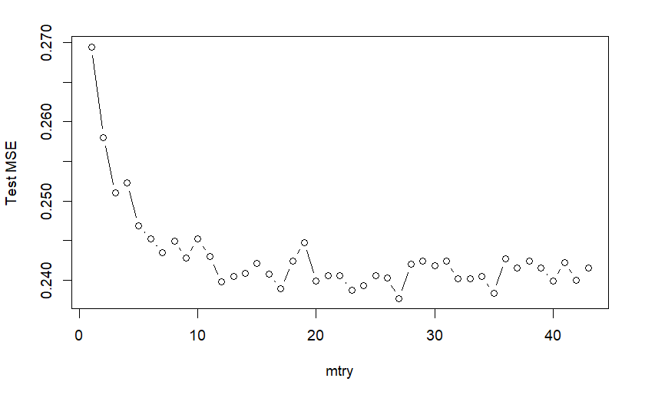
Random Forest Hyperparameter Tuning
Base model hyperparameter tuning was performed on “mtry”, the number of variables randomly sampled as candidates at each split.
Results indicated a drop in test MSE after mtry = 12, with the lowest test MSE resulting from mtry = 27.
128 trees were chosen given the speed of training and minor changes in model accuracy with greater values.
Mtry = 17 and mtry = 10 were used for variations 3 and 4 respectively.

Slide 18
Random Forest Model Results
The following accuracy and test errors were produced by each variation:
Variation | Test Error | Accuracy
Base Model | 0.2399 | 0.7601
Variation 1 | NA | NA
Variation 2 | NA | NA
Variation 3 | 0.2414 | 0.7586
Variation 4 | 0.3720 | 0.6280
Note Variations 1 and 2 could not be applied to a random forest. Variations 3 and 4 were still considered to see impact.

Slide 19
XGBoost Hyperparameter Tuning
Hyperparameter tuning was performed on XGBoost using a grid search method on parameters: max_depth, min_child_weight, subsample, and colsample_bytree.
max_depth: maximum depth of a tree
min_child_weight: minimum sum of weights of all observations required in a child
subsample: fraction of samples to be used for fitting the individual base learners
colsample_bytree: subsample ratio of dataset columns when constructing each tree
Received a cross-validation accuracy score of 0.771 with tuned model.

Slide 20
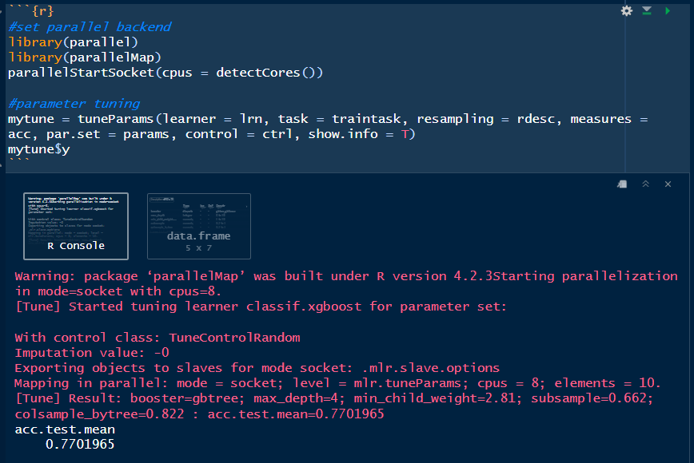
XGBoost Hyperparameter Tuning – Run Results
max_depth = 4; min_child_weight = 2.81; subsample = 0.662; colsample_bytree = 0.822

Slide 21
XGBoost Model Results
The following accuracy and test errors were produced by each variation:
Variation | Test Error | Accuracy
Base Model | 0.2315 | 0.7685
Variation 1 | NA | NA
Variation 2 | NA | NA
Variation 3 | 0.2374 | 0.7626
Variation 4 | 0.3678 | 0.6322
Note Variations 1 and 2 could not be applied to an XGBoost. Variations 3 and 4 were still considered to see impact.

Slide 22
SVM Hyperparameter Tuning
Hyperparameter tuned on kernel type: linear or radial
Hyperparameter tuned on the cost function, which seeks to approximate the logistic function with a piecewise linear; a higher cost allows the SVM to “bend” more with the data.
Cost values: {0.001, 0.01, 0.1, 1, 5, 10, 100}
Note, due to size of data, only 1000 samples of the data were used for tuning
Notes:
https://www.analyticsvidhya.com/blog/2017/10/svm-skilltest/#:~:text=Explanation%3A%20The%20cost%20parameter%20decides,as%20the%20cost%20of%20misclassification.

Slide 23
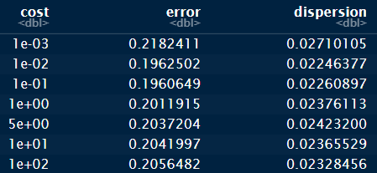
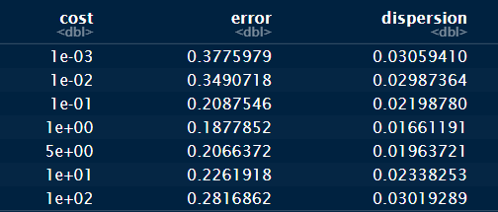
SVM Hyperparameter Tuning - Results
Linear Kernel Results
Radial Kernel Results
Linear kernel and cost of 0.01: test error = 0.1961
Radial kernel and cost of 1:
test error = 0.1878

Slide 24
SVM Model Results
The following accuracy and test errors were produced by each variation using a radial kernel, cost value of 1, and gamma of 0.0233:
Variation | Test Error | Accuracy
Base Model | 0.2347 | 0.7653
Variation 1 | 0.2367 | 0.7633
Variation 2 | 0.2361 | 0.7639
Variation 3 | 0.2424 | 0.7576
Variation 4 | 0.3604 | 0.6396

Slide 25
Gaussian Naïve Bayes Model Results
The following accuracy and test errors were produced by each variation:
Variation | Test Error | Accuracy
Base Model | 0.2934 | 0.7066
Variation 1 | NA | NA
Variation 2 | NA | NA
Variation 3 | 0.2913 | 0.7087
Variation 4 | 0.3856 | 0.6144
Note Variations 1 and 2 could not be applied. Variations 3 and 4 were still considered to see impact.

Slide 26
...so which model and variation type performed the best?
Model | Variation | Test MSE | Accuracy
Logistic | Variation 1 | 0.2276 | 0.7724
Random Forest | Base Model | 0.2399 | 0.7601
XGBoost | Base Model | 0.2315 | 0.7685
SVM | Base Model | 0.2347 | 0.7653
Gaussian Naïve Bayes | Variation 3 | 0.2913 | 0.7087

Slide 27
What can we take away from these results?
The Logistic Model with Variation 1 had the best results with an accuracy of 77.24%
This model produced the following confusion matrix:
Actual
 | 0 | 1
0 | 1937 | 703
1 | 927 | 3595
Predicted

Slide 28
What can we take away from these results?
Confusion matrix suggests 703 false negatives and 927 false positives for predicting that the home team wins a game.
If a sports betting company would profit off a home team winning, then false positives should be a concern.
If a sports betting company would profit off a home team losing, then false negatives should be a concern.
False Positive Rate = 0.324
False Negative Rate =0.164
Actual
 | 0 | 1
0 | 1937 | 703
1 | 927 | 3595
Predicted

Slide 29
What decisions should be made based on our findings?
The logistic regression model is arguably the simplest model out of the five tested, making it appealing for implementation.
An accuracy score of around 77.4% is a great starting point, but the lack of variation between accuracy scores and models may suggest that the models could benefit from additional predictor variables. This is also shown from a general model performance decrease when removing variables.
The logistic model has more of a tendency to produce false positives. This should be noted by sports betting companies who may implement this model.

Slide 30
What we have learned in summary...
Multicollinearity hardly impacts tree-based models with this dataset.
Game outcomes mainly come down to a team’s point differentials from previous games and their winning percentage at home and on the road.
More game statistics could benefit prediction. Some statistics to consider include player statistics and a team’s injury report.
Classification models can make predicting an NBA game outcome possible, which would be useful to both NBA franchises and sports betting companies.

Slide 31
Thank you!
For more information on the original dataset, visit:
https://www.kaggle.com/datasets/nathanlauga/nba-games
For more information on the transformed dataset, visit:
https://github.com/deangelini/DS504FinalProject/blob/main/master_games.csv
For more information on the classification models, visit:
https://github.com/deangelini/DS504FinalProject/blob/main/DS504_models.Rmd
Continue the conversion with us online:
Danielle Angelini, deangelini@wpi.edu

Slide 32
Additional Resources
Badenhausen, Kurt, and Kurt Badenhausen. “NBA Valuations: Warriors Top $7.6 Billion as Teams Average $3 Billion.” Sportico.com, 13 Dec. 2022, www.sportico.com/feature/nba-valuations-average-team-worth-billion-warriors-1234698263/.
“Beginners Tutorial on XGBoost and Parameter Tuning in R Tutorials & Notes: Machine Learning.” HackerEarth, HackerEarth, https://www.hackerearth.com/practice/machine-learning/machine-learning-algorithms/beginners-tutorial-on-xgboost-parameter-tuning-r/tutorial/.
Bunker, Rory P, and Thadi Thabtah. “A Machine Learning Framework for Sport Result Prediction.” Applied Computing and Informatics, Elsevier, 19 Sept. 2017, https://www.sciencedirect.com/science/article/pii/S2210832717301485.
Duan, James. “Exploratory Data Analysis of Home Team Advantage in the NBA 2004–2020.” Medium, Medium, 8 Mar. 2021, https://jyduan-8715.medium.com/exploratory-data-analysis-of-home-team-advantage-in-the-nba-2004-2020-58c9922a8744.
Duan, James. “Predicting the Outcome of NBA Games Using Machine Learning.” Medium, Nerd For Tech, 12 May 2021, https://medium.com/nerd-for-tech/predicting-the-outcome-of-nba-games-using-machine-learning-676a62549040.
Houde, Matthew. “Predicting the Outcome of NBA Games - Bryant University.” Bryant Digital Repository, Bryant University, Apr. 2021, https://digitalcommons.bryant.edu/cgi/viewcontent.cgi?article=1000&context=honors_data_science.
“Industry Market Research, Reports, and Statistics.” IBISWorld, 31 Jan. 2023, https://www.ibisworld.com/industry-statistics/market-size/sports-franchises-united-states/.
Jones, Eric Scot. “Predicting Outcomes of NBA Basketball Games - North Dakota State University.” North Dakota State University Library, North Dakota State University, Apr. 2016, https://library.ndsu.edu/ir/bitstream/handle/10365/28084/Predicting%20Outcomes%20of%20NBA%20Basketball%20Games.pdf?sequence=1.
Lauga, Nathan. “NBA Games Data.” Kaggle, 23 Dec. 2022, https://www.kaggle.com/datasets/nathanlauga/nba-games?resource=download.
“Naïve Bayes Classifier.” Naïve Bayes Classifier · UC Business Analytics R Programming Guide, https://uc-r.github.io/naive_bayes.
Ozanian, Mike. “NBA Team Values 2022: For the First Time in Two Decades, the Top Spot Goes to a Franchise That's Not the Knicks or Lakers.” Forbes, Forbes Magazine, 29 Oct. 2022, https://www.forbes.com/sites/mikeozanian/2022/10/27/nba-team-values-2022-for-the-first-time-in-two-decades-the-top-spot-goes-to-a-franchise-thats-not-the-knicks-or-lakers/?sh=87cfe671ccec.
“Sports Betting Market Size & Share Report, 2021-2028.” Www.grandviewresearch.com, www.grandviewresearch.com/industry-analysis/sports-betting-market-report#:~:text=The%20sports%20betting%20market%20was.
“SVM Skill Test: 25 MCQs to Test a Data Scientist on SVM (Updated 2023).” Analytics Vidhya, 5 Oct. 2017, www.analyticsvidhya.com/blog/2017/10/svm-skilltest/#:~:text=Explanation%3A%20The%20cost%20parameter%20decides. Accessed 28 Apr. 2023.

